Slide 1
Reverse Engineer a Merge Tree from Topology Information
He Chen, Tart Patel

Slide 2
Merge Tree From Scalar Field

Slide 3
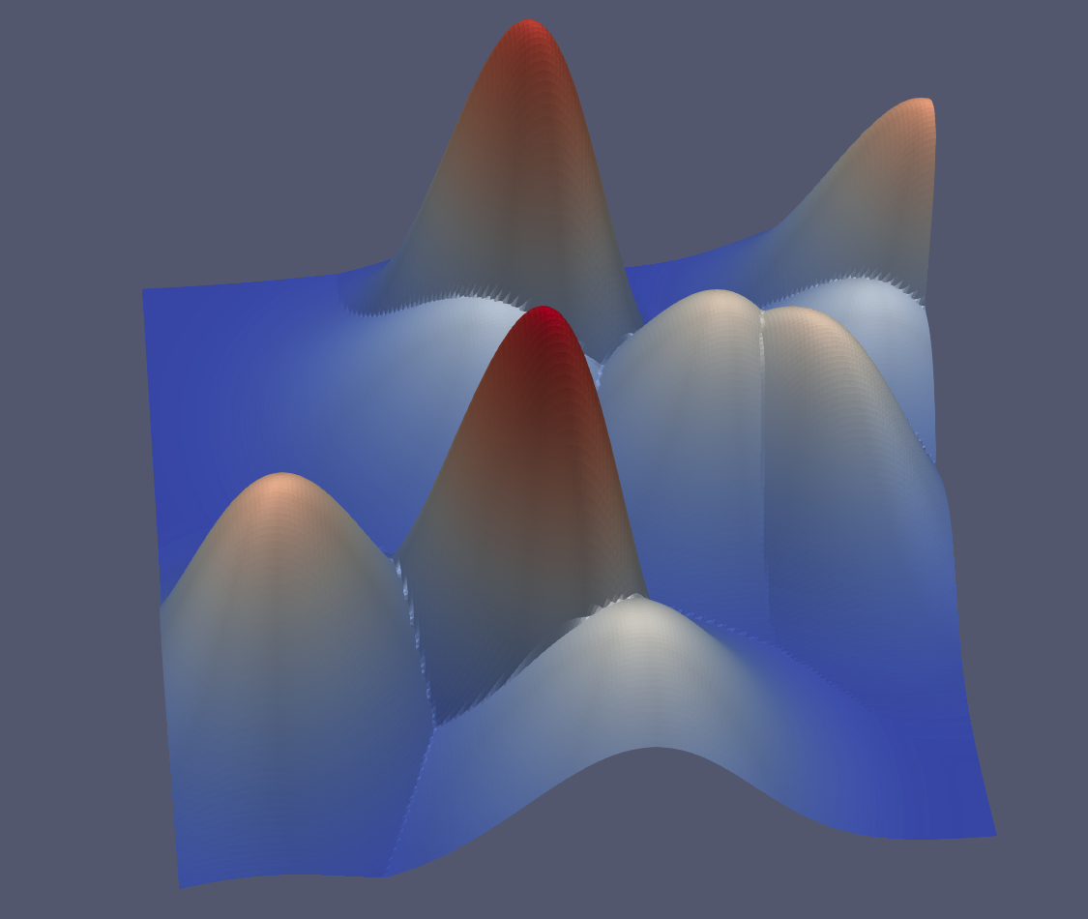
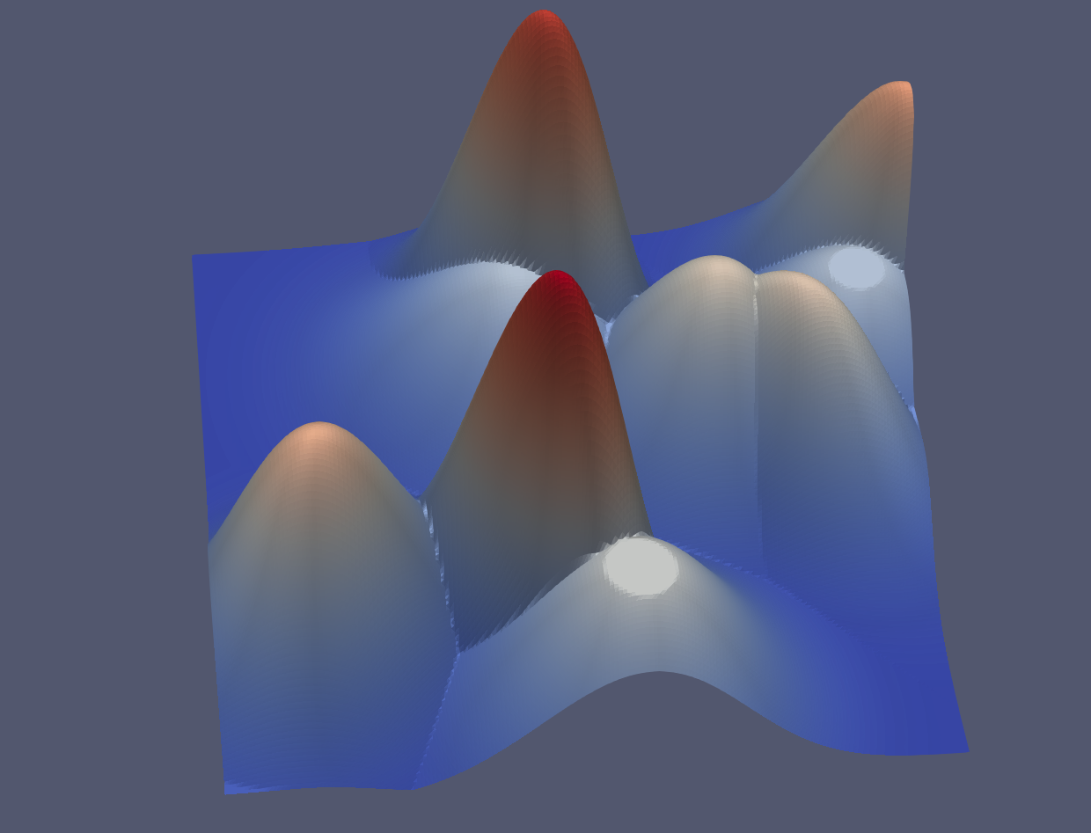
Topological Simplification
Input
Simplified

Slide 4
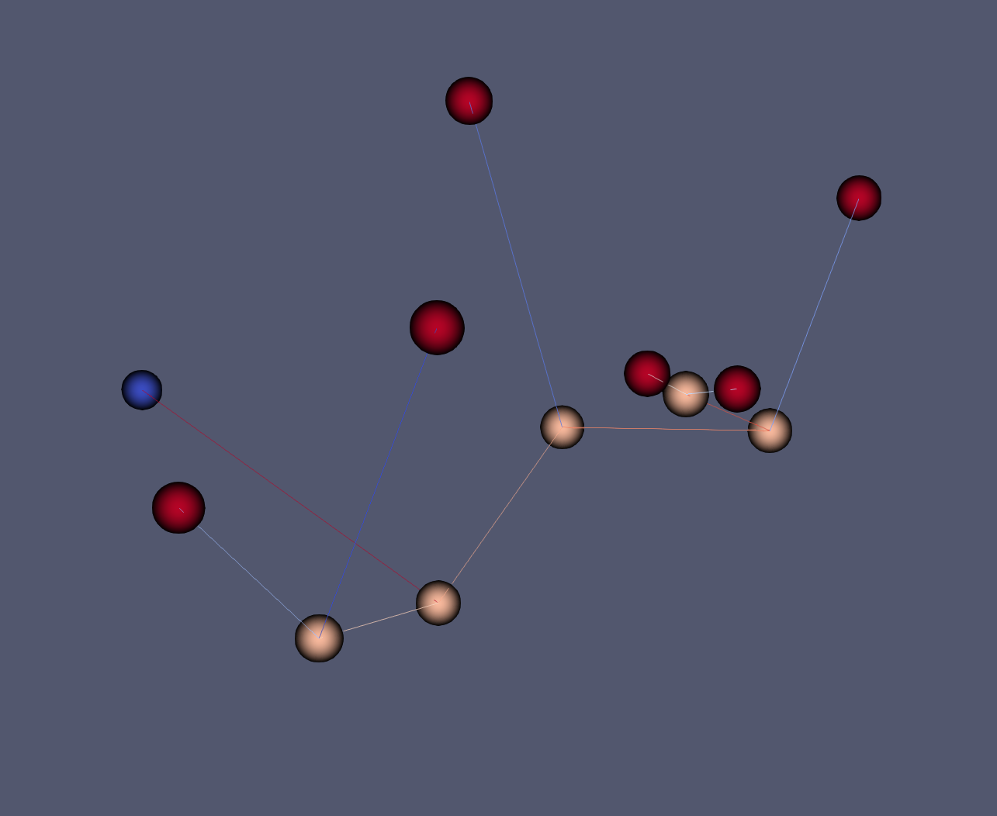
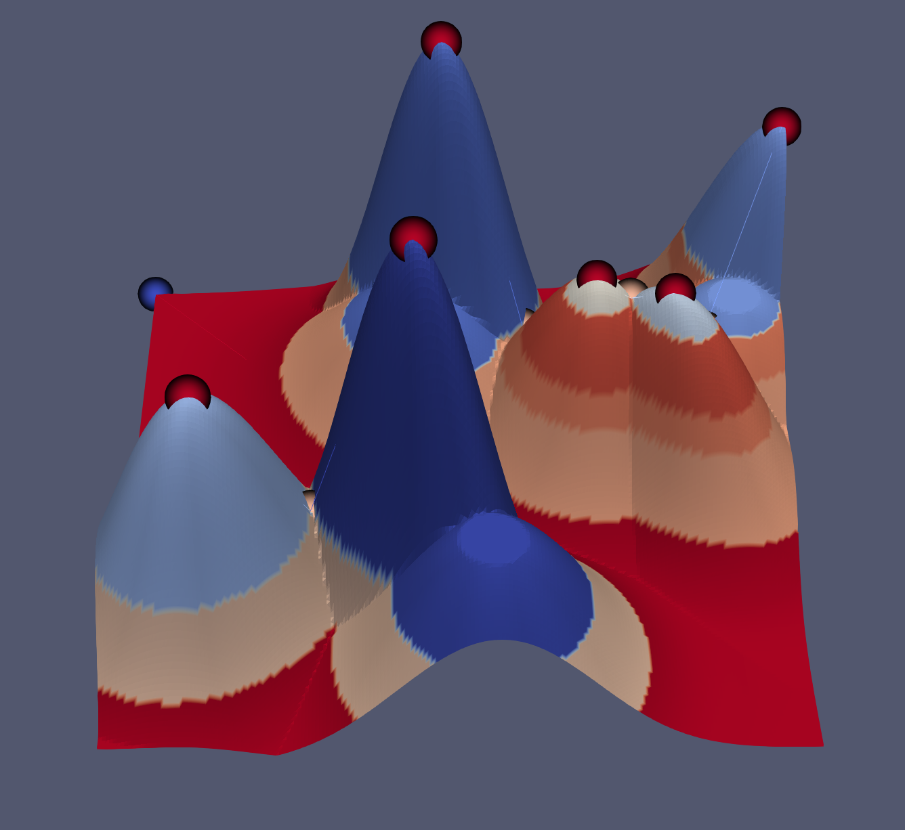
Merge Tree
Merge tree
Segmentation

Slide 5
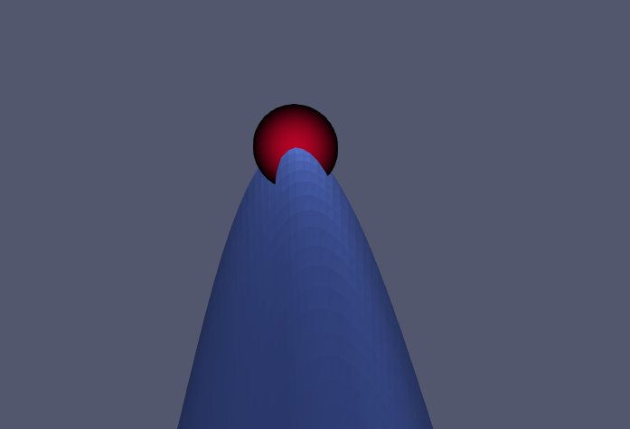
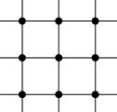
Critical Points: Local Maximum
Local Maximum
Corresponds to Leaf Node in the Merge Tree

Slide 6
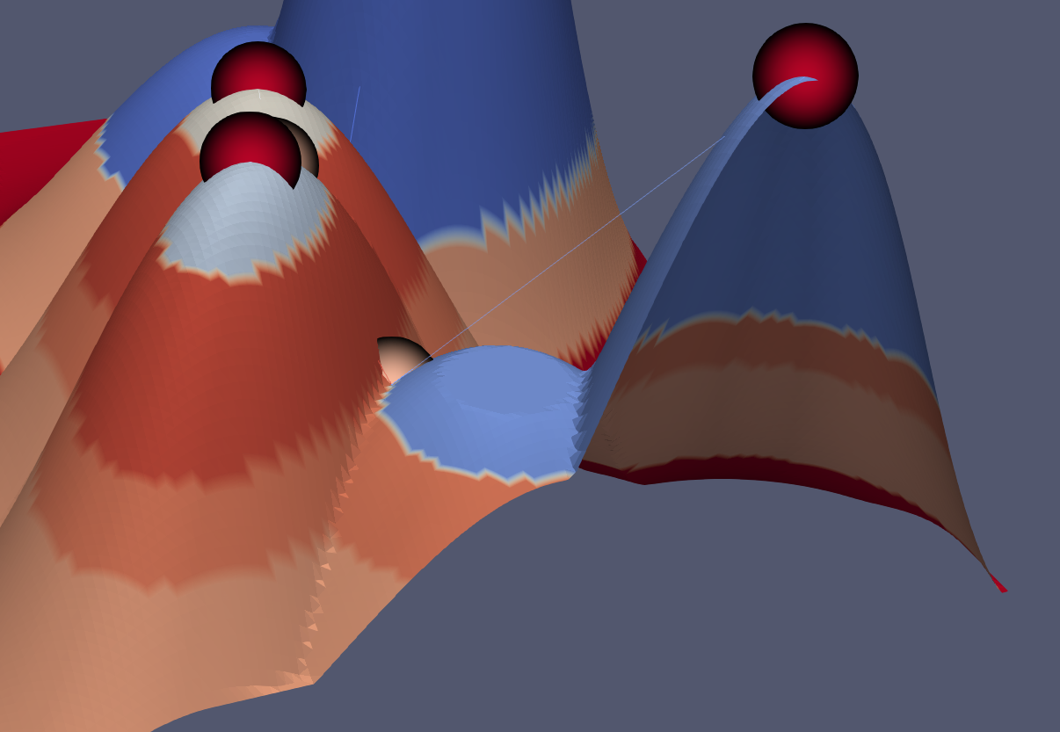
Critical Points: Saddle point
Saddle point
Where two or more connected component join

Slide 7
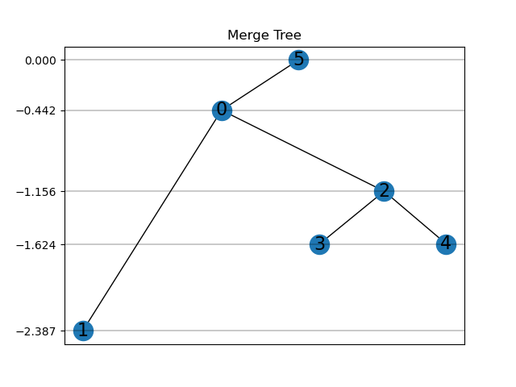
Merge Tree to Induced Matrix
Induced matrices are an intemediate form for interpolation
Data Layout
Symmetric
The diagonal values M_{i,i} are the function value of node i
The value M_{i,j} is the function value where nodes i and j merge
0 | 0 | 0 | 0 | 0 | 5
 | 1 | 0 | 0 | 0 | 5
 |  | 2 | 2 | 2 | 5
 |  |  | 3 | 2 | 5
 |  |  |  | 4 | 5
 |  |  |  |  | 5

Slide 8
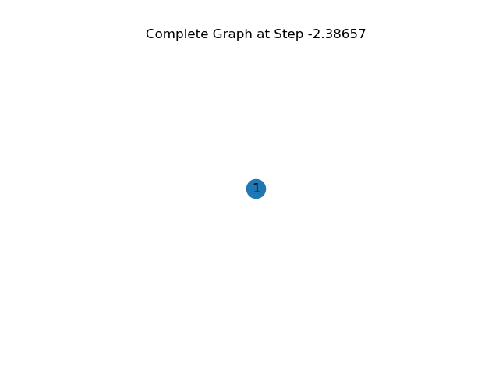
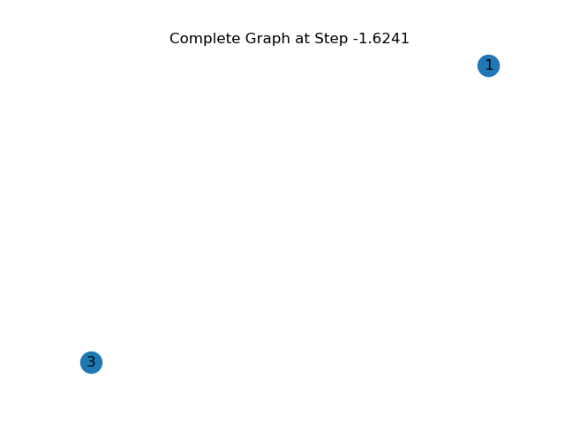
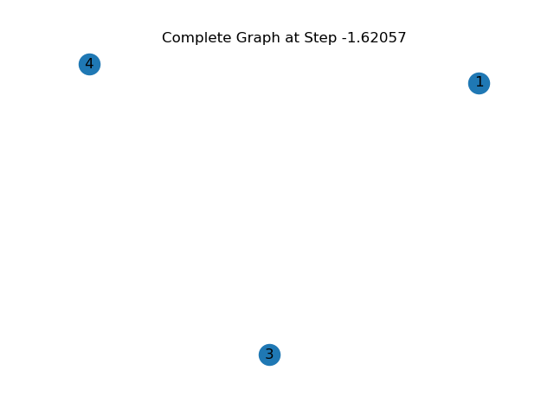
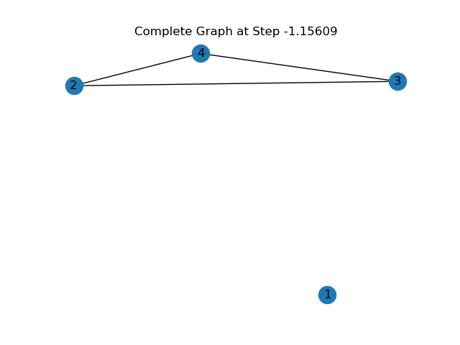
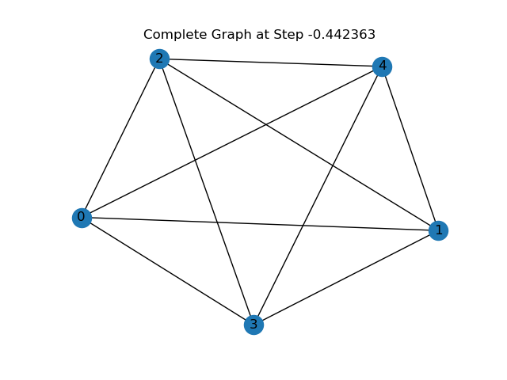
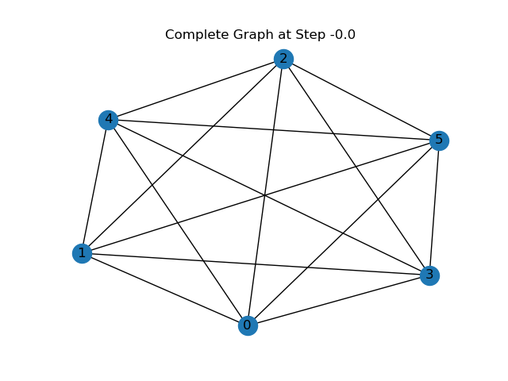
Induced Matrix to Merge Tree
To construct a merge tree from an induced matrix, the nodes and edge of the tree must be sorted by the function value
Then all of the function values are traversed in order and any nodes or edges are added to the graph
The steps are represented by complete graphs that are fully connected by the last step

Slide 9
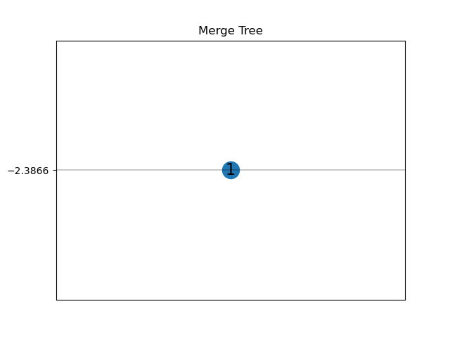
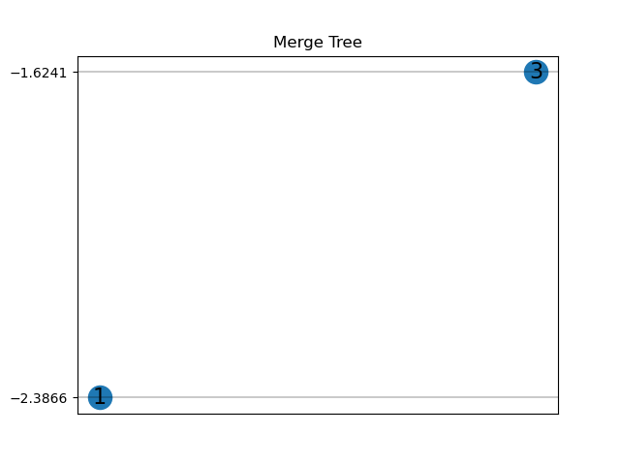
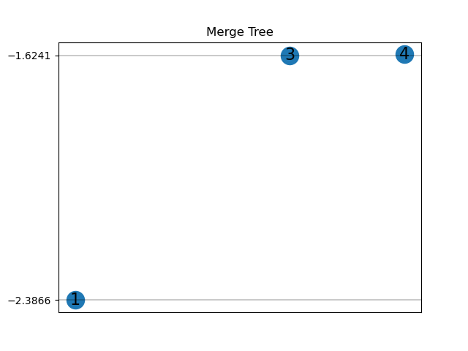
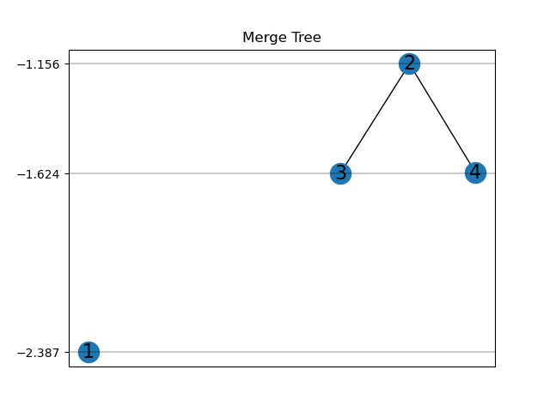
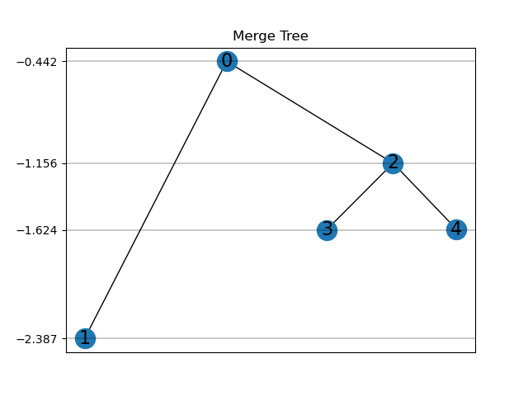
Induced Matrix to Merge Tree
To construct a merge tree from an induced matrix, the nodes and edge of the tree must be sorted by the function value
Then all of the function values are traversed in order and any nodes or edges are added to the graph
The steps are represented by complete graphs that are fully connected by the last step

Slide 10
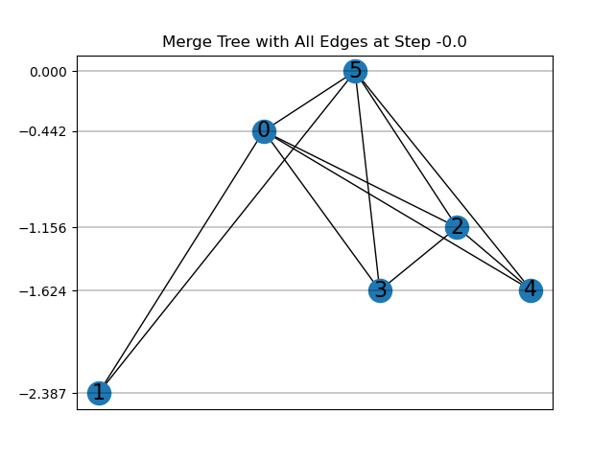
Induced Matrix to Merge Tree
Adding edges to the graph in the order of steps left redundant connections
With entirely labeled nodes, the only case is when the connecting node appears in the middle of the steps
With unlabeled nodes, the edge that needs to be removed depends on its function value

Slide 11
Merge Tree Interpolation
Interpolation can be done in the induced matrix form
Merge tree interpolation methods
Linear interpolation
Simple and fast
Geodesic interpolation
More computationally expensive,
but produces better results

Slide 12
Critical Points: Discrete Definition
[Charles et al. 2017] [T. F. Banchoff. et al. 1970]
Local minimum
Local maximum
Saddle point:
Inclining directions are separatedby declining directions
Regular point:
Inclining directions and declining directions are simply connected
Points with higher value
Points with lower value

Slide 13
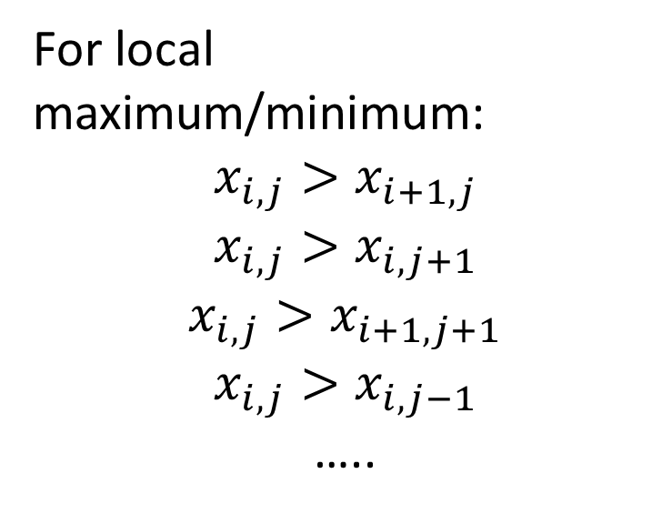
Critical Points: Discrete Definition
For local maximum/minimum:
$$x_{i,j}>x_{i+1,j}$$
$$x_{i,j}>x_{i,j+1}$$
$$x_{i,j}>x_{i+1,j+1}$$
$$x_{i,j}>x_{i,j−1}$$
…..
Local maximum
Local minimum

Slide 14
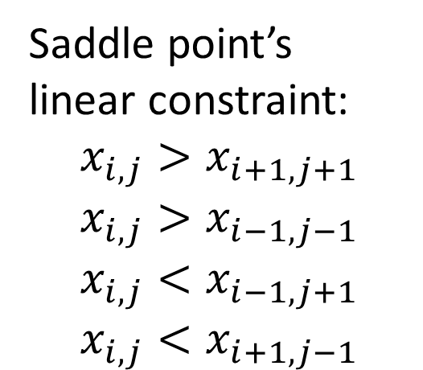
Critical Points: Discrete Definition
Local maximum 1 (leaf 1)
Saddle point’s linear constraint:
$$x_{i,j}>x_{i+1,j+1}$$
$$x_{i,j}>x_{i−1,j−1}$$
$$x_{i,j}<x_{i−1,j+1}$$
$$x_{i,j}<x_{i+1,j−1}$$
Saddle point where they join
Local maximum 2 (leaf 2)

Slide 15
Critical Points: Discrete Definition
Local maximum 1 (leaf 1)
Saddle point’s linear constraint:
$$x_{i,j}>x_{i+1,j+1}$$
$$x_{i,j}>x_{i−1,j−1}$$
$$x_{i,j}<x_{i−1,j+1}$$
$$x_{i,j}<x_{i+1,j−1}$$
Saddle point where they join
Local maximum 2 (leaf 2)

Slide 16
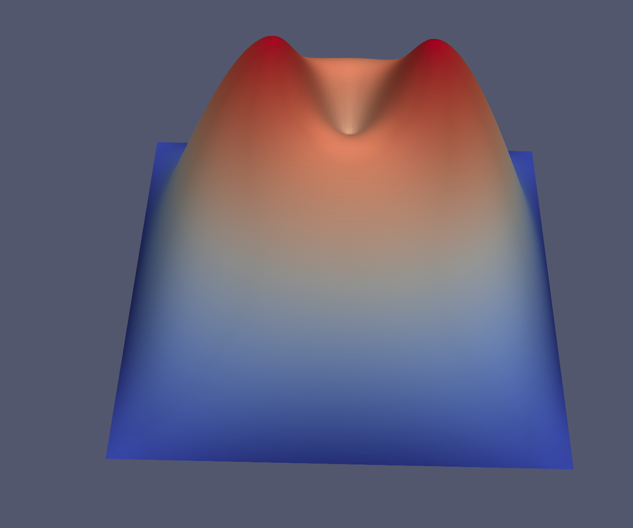
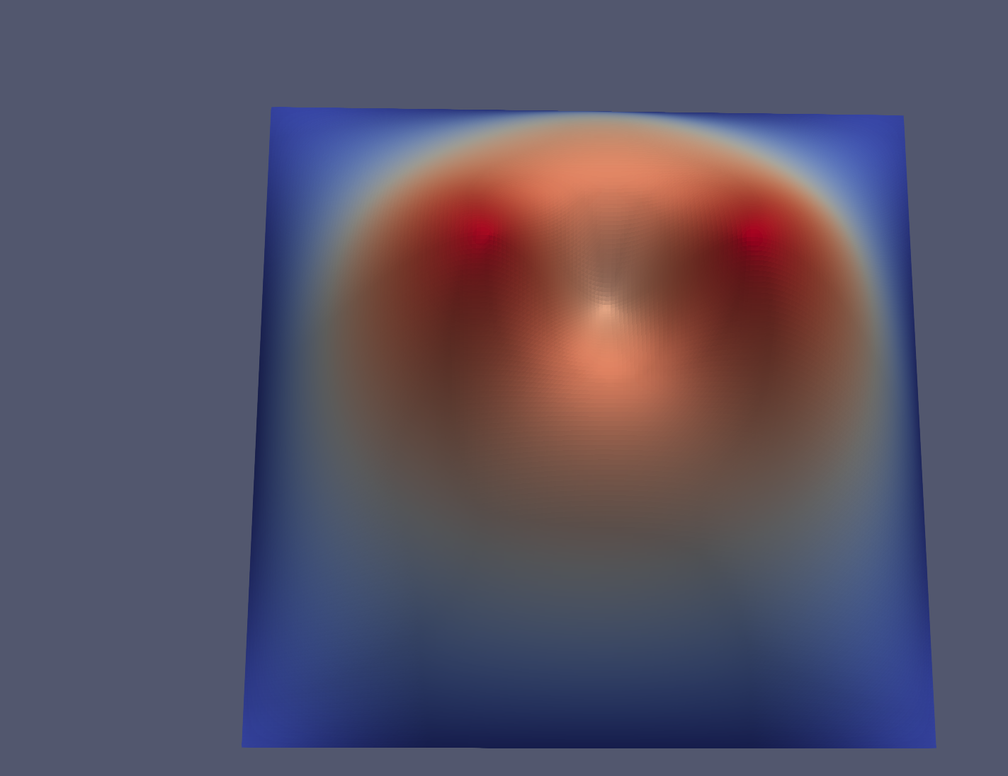
Critical Points: Discrete Definition
Local constraint is not sufficient for
creating saddle points.

Slide 17
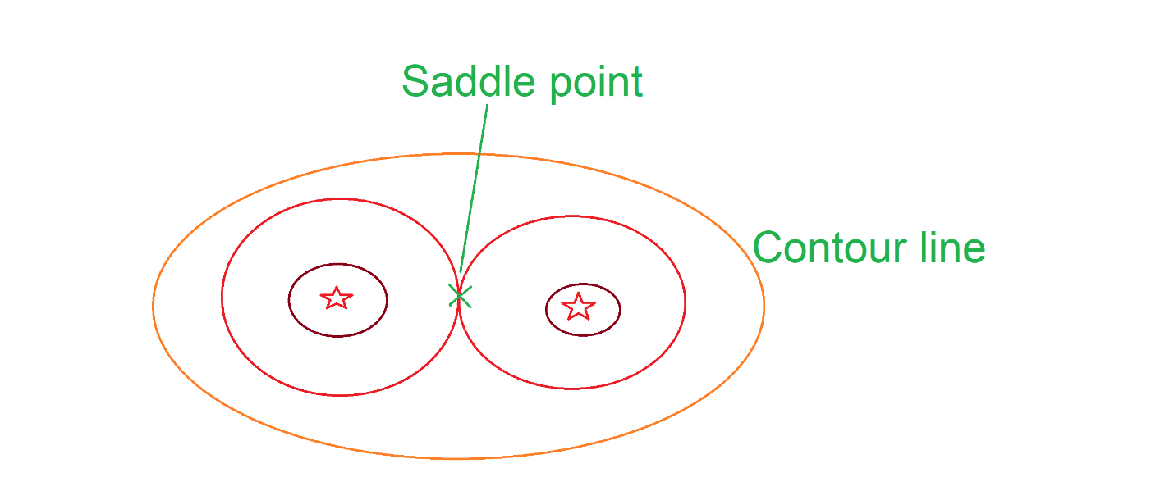
Contour Line Constraint
We have to use global constraint to make sure components join at a certain saddle point.
The solution is to add contour line
to make sure the two component contacts exactly at the saddle point

Slide 18
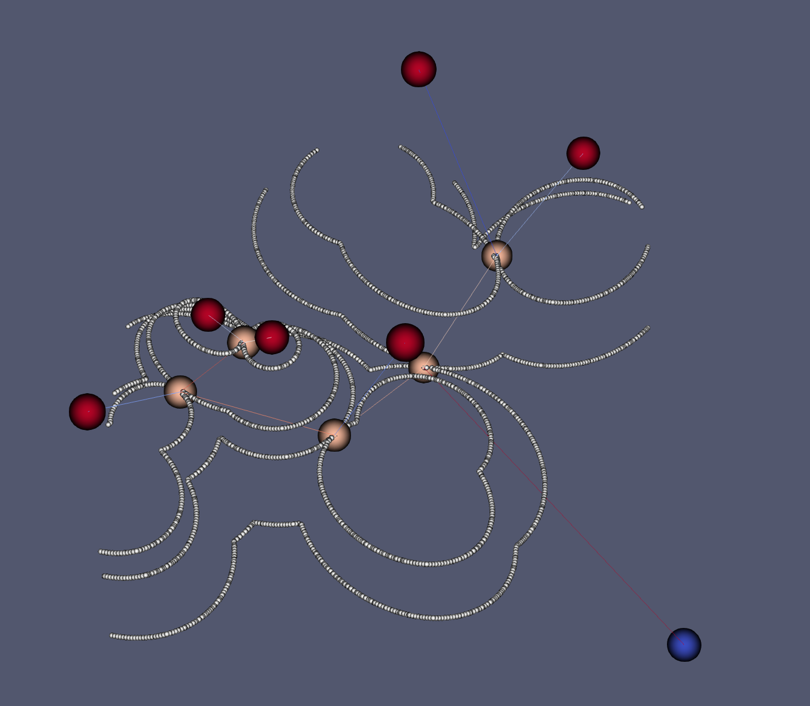
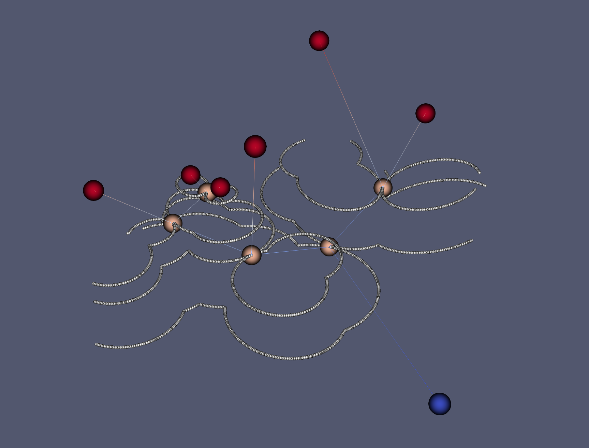
Constraints:
Critical points constraints (local, inequality) + contour line constraints (global, equility)

Slide 19
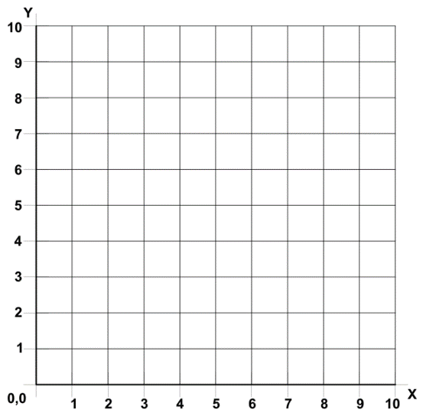
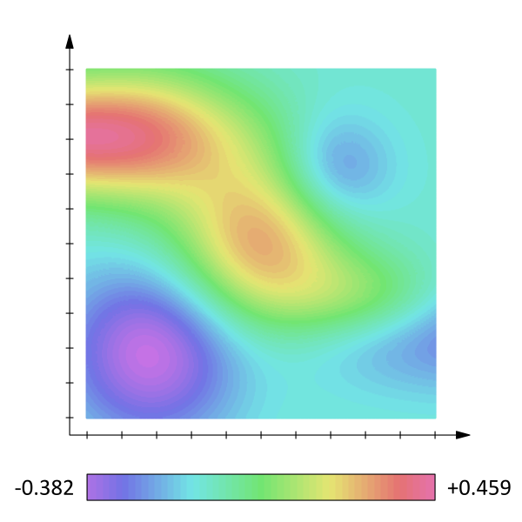
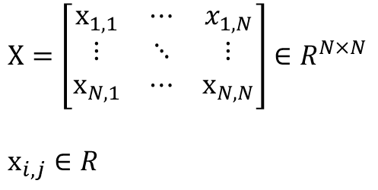
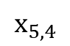
Fill the Rest of the Points
$$X=\left[\begin{matrix}x_{1,1} & ⋯ & x_{1,N} \\ ⋮ & ⋱ & ⋮ \\ x_{N,1} & ⋯ & x_{N,N}\end{matrix}\right]∈R^{N×N}$$
$$x_{i,j}∈R$$
$$x_{5,4}$$
Define scalar field on a 2D regular grid (image)

Slide 20
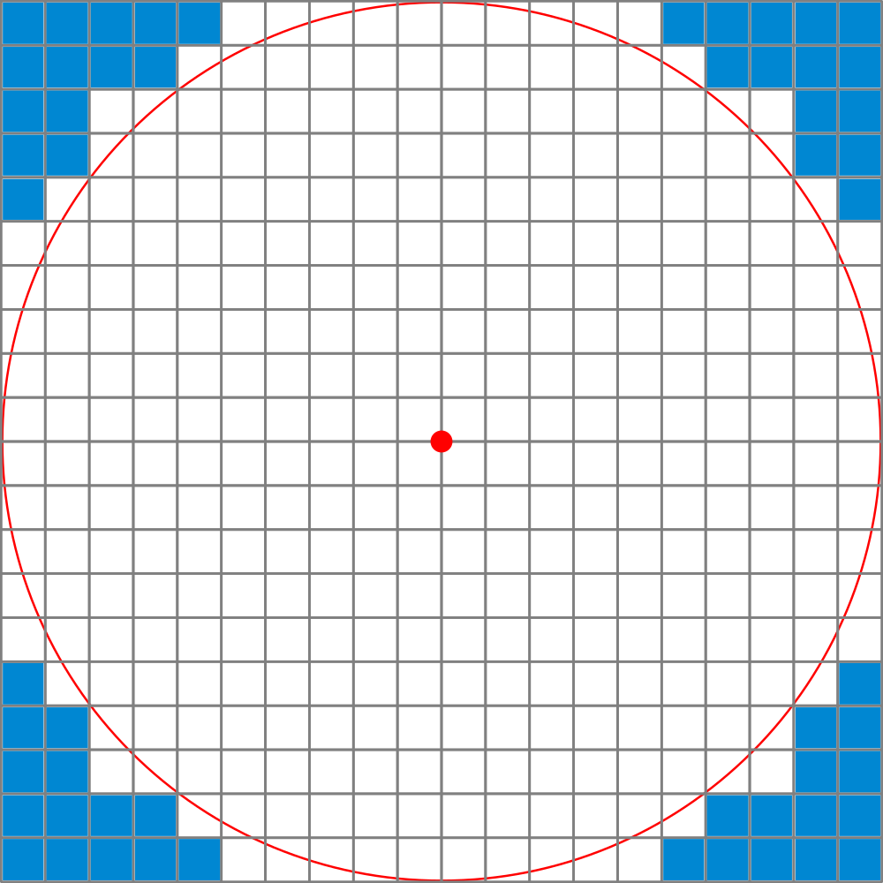
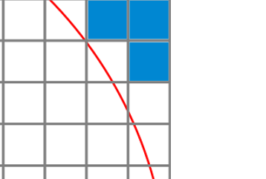

Contour Line Constraint
$${λx}_{i,j}+{(1−λ)x}_{i,j+1}=h$$

Slide 21
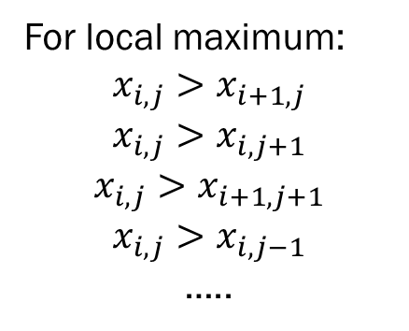
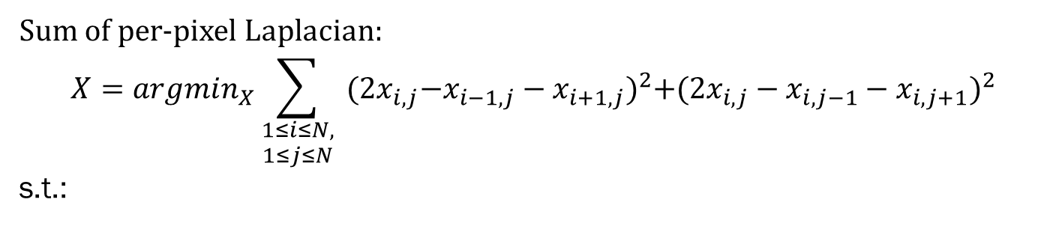


Fill the Rest of the Points
Sum of per-pixel Laplacian:
$$X=argmin_{X}\sum_{\begin{aligned}1≤i≤N, \\ 1≤j≤N\end{aligned}}{{{ (2x}_{i,j}−x_{i−1,j}−x_{i+1,j})}^{2}{{+(2x}_{i,j}−x_{i,j−1}−x_{i,j+1})}^{2}}$$
s.t.:
For local maximum:
$$x_{i,j}>x_{i+1,j}$$
$$x_{i,j}>x_{i,j+1}$$
$$x_{i,j}>x_{i+1,j+1}$$
$$x_{i,j}>x_{i,j−1}$$
…..
Saddle constraint:
$$x_{i,j}>x_{i+1,j+1}$$
$$x_{i,j}>x_{i−1,j−1}$$
$$x_{i,j}<x_{i−1,j+1}$$
$$x_{i,j}<x_{i+1,j−1}$$
Contour line constraint:
$${λx}_{i,j}+{(1−λ)x}_{i,j+1}=h$$
…..
All linear equality / inequality constraint

Slide 22
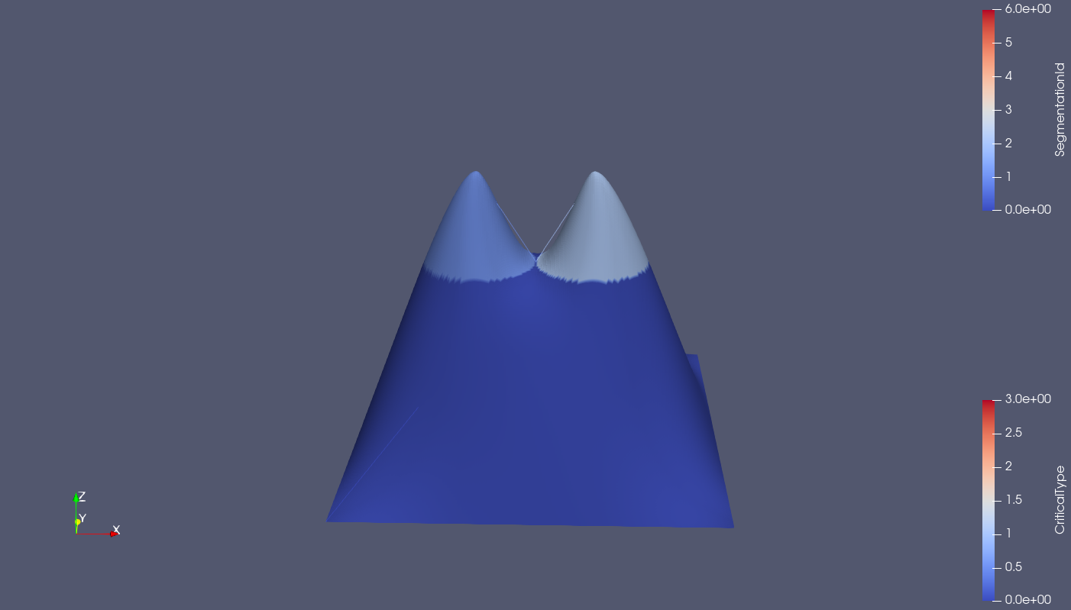


Example

Slide 23
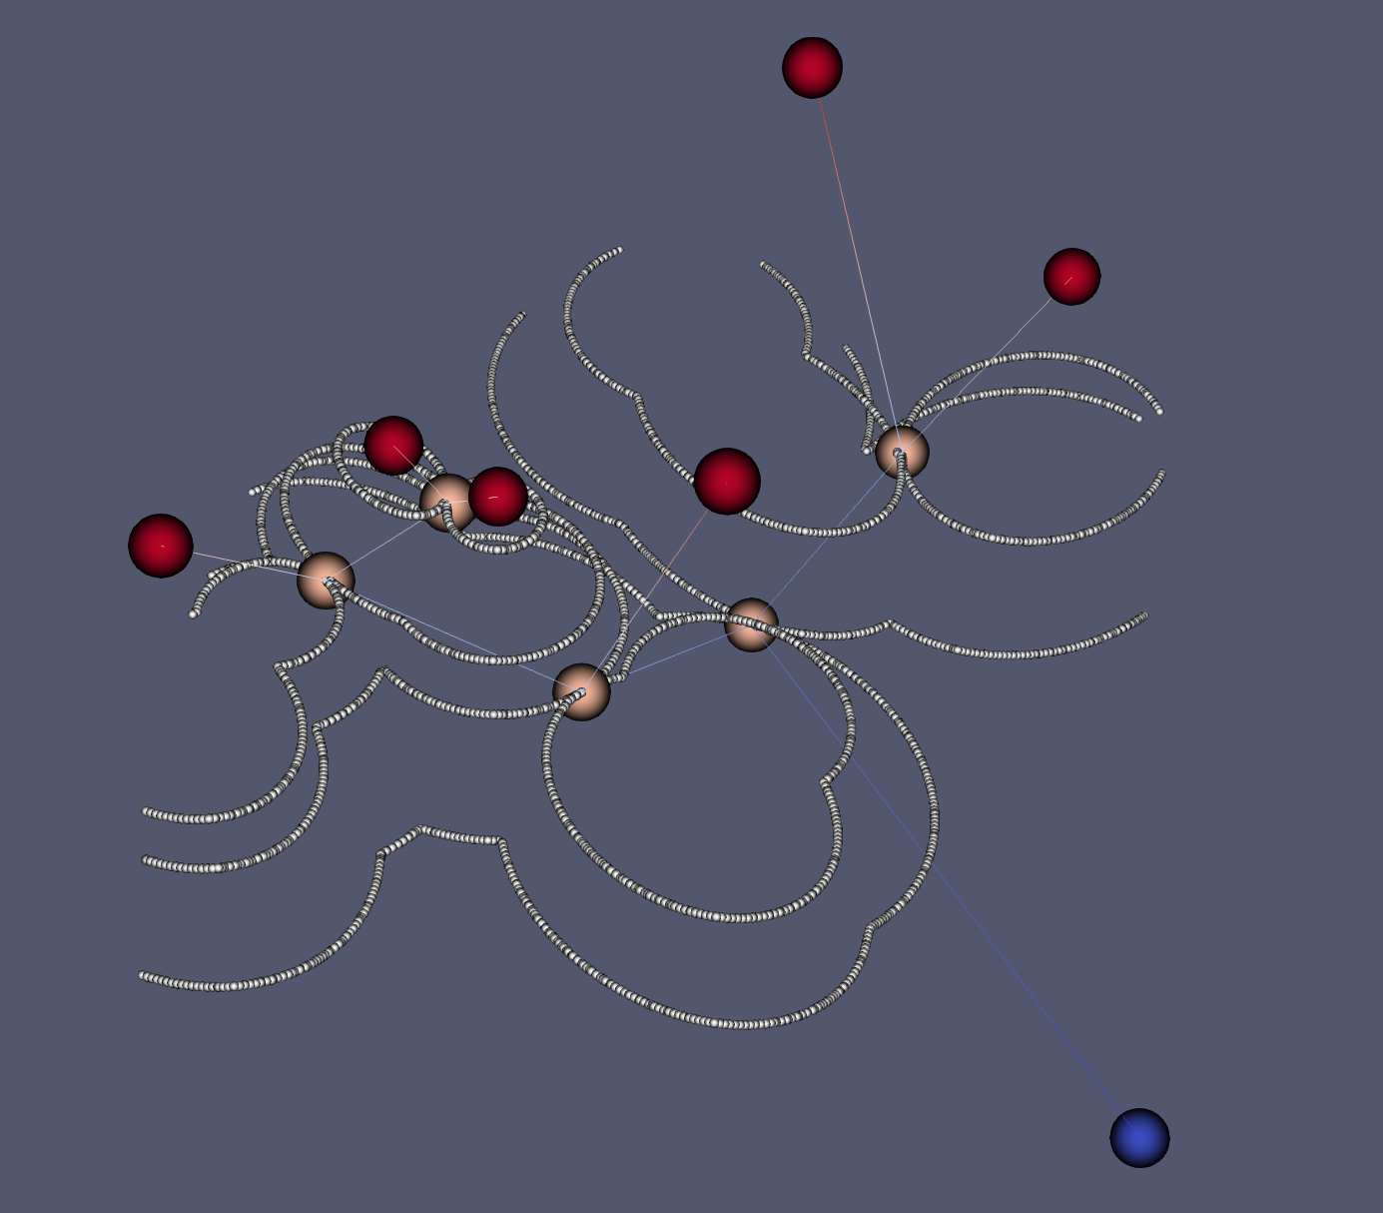
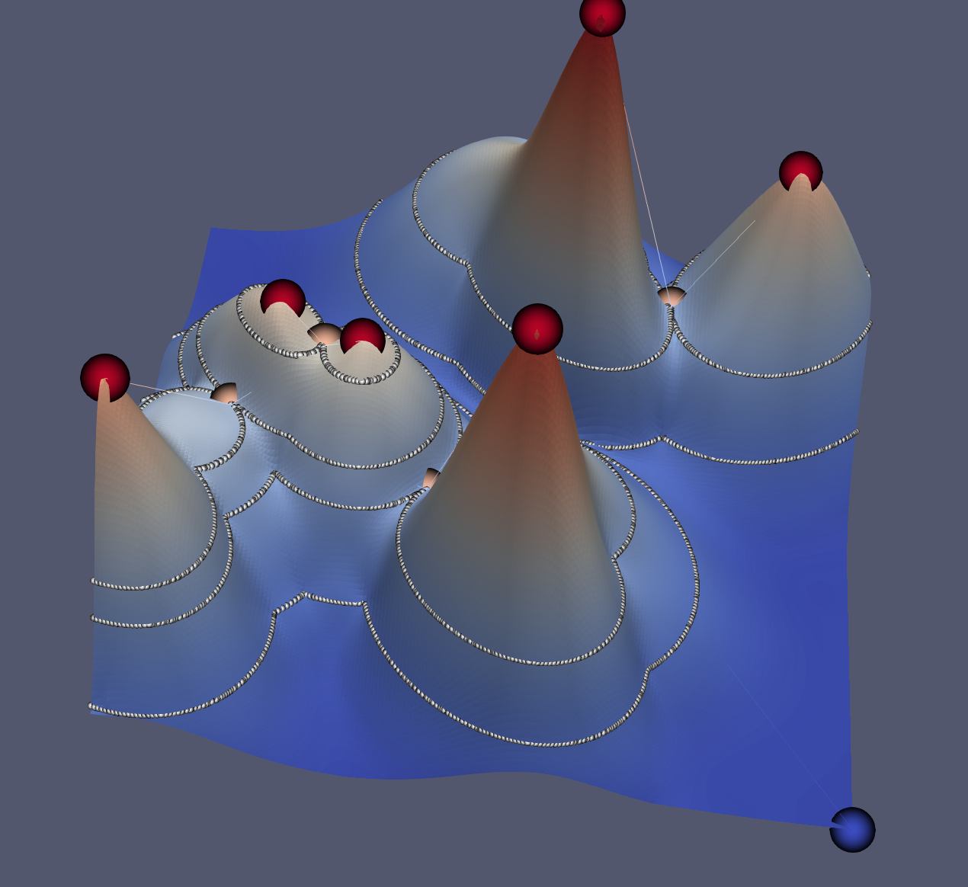
Example

